Slide 1
JSF 101
Mihaly Fodor

Slide 2
Program
09.00-12.30
Partea teoretica
14:00-18:00
Partea practica
Pauze de 10 min/ora

Slide 3
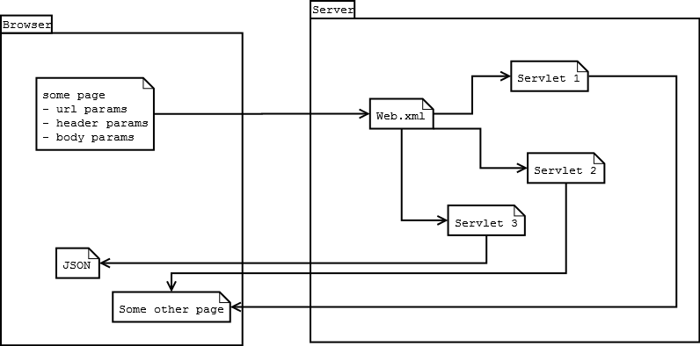
Before everything else…
JSF 101
Notes:
Servlets are important! How do requests work on a very basic level in JEE?
Browser launches the request
Values could be gathered in a Form and packed into the request body automatically
They can also appear in the URL
Or both can be true
And you can also build requests like these manually if not sent from a browser (from Java, or testing tools)
Request Header can also have some parameters
WebContainer catches the request and finds the appropiate Servlet to handle it
Checks the request url, and matches it to any rules declared in web.xml
Sends it on ist way
Spoiler: JSF will have one single servlet, that catches all requests and then routs them internally
Servlet gets the request
doGet or doPost gets called, httpRequest, httpResponse
You get access to the entire parameter list in a single key-value Map
Irrelevant if it was sent as GET or POST
You also get access to any other header parameters that maybe were set, though at this point you can ignore this
You need to provide some response
Usually html or a .jsp page
Can be anything that a client can understand

Slide 4
Overview
JSF 101
Part 1
What is JSF?
Example01
JSF tags
Navigation rules
Backing beans
Using EJBs
Adding error messages
Example02
Listeners
Validators
Session handling
Primefaces
Part 2
Small Project
Jsf + primefaces

Slide 5
What is JSF?
JSF 101
„UI component based Java Web application framework“
Official documentation:
Drop components onto a page by adding component tags
Wire component-generated events to server-side application code
Bind UI components on a page to server-side data
Construct a UI with reusable and extensible components
Save and restore UI state beyond the life of server requests
Based on MCV
Notes:
Basic web projects is Servlets + .jsp-s and jdbc for backend
One possible improvement is adding Hibernate or JPA for backend
Another step could be adding EJBs for application logic
And finally adding JSF for the Web part, just to make our lives simpler.
JSF basically reduces complexity and saves you from writing basic stuff, similarly how going from JDBC to JPA makes managing entities a lot easier
For example imagine a simple request: simple application with two screens:
Login
Username and password fields
I18n
Input validation
Error handling
Session handling
Main
Rich text edditor
Logout
We will see how much simpler this is with JSF and PrimeFaces compared to just Servlets and .jsp-s

Slide 6
Hello World
JSF 101
Servlet
Java Class
doPost
doGet
Web.xml
Servlet declaration
Servlet mapping
Index page
Jsp
Index page
Web.xml
Nothing of interest
JSF
HelloBean
Backing Bean
SessionScoped
Navigation
Index.xhtml, Hello.xhtml
Jsf Tags
Expression language
Xhtml format
Web.xml
Faces servlet mapping
Main JSF Servlet
Servlet mapping
What patterns to look for
Notes:
Just a quick recap, to compare the complexity progression and capabilities of the technologies
I always say that these build on each other, in the order of Servlet -> JSP -> JSF
You can‘t really understand the more complex ones bevor knowing the others well
Even JSF has a servlet at ist core that needs to be declared in web.xml…
Servlet
Basic building block of java web
We have our 2 most important methods
Needs to be declared in web.xml, so the application container knows where to rout the requests to
Stays at the very core of every webapp, even if you don‘t directly create it
JSP
One step up, but still a servlet at its core
Makes writing page markup easier
JSF
The focus ot this presentation
Makes life a lot easier

Slide 7
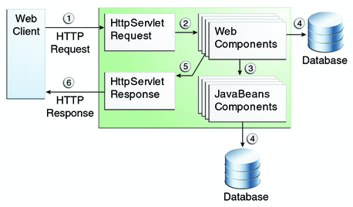
Web Application Request Handling
JSF 101
https://docs.oracle.com/javaee/6/tutorial/doc/geysj.html
Notes:
Basic Request Lifecicle
Browser launches the request
Values could be gathered in a Form and packed into the request body automatically
They can also appear in the URL
Or both can be true
And you can also build requests like these manually if not sent from a browser (from Java, or testing tools)
WebContainer catches the request and finds the appropiate Servlet to handle it
Checks the request url, and matches it to any rules declared in web.xml
Sends it on ist way
JSF has one single servlet, that catches all requests and then routs them internally
WebComponents gets the request
You get routed here by the JSF servlet
You can acces any parameters you have mapped, we will see later
Here you can choose to send a response
Or call some other application logic
Or access the database
But at the end you need to send the response from here, any of the above two actions normally return after done
Calling JavaBeans components
You can call any application logic you wish
Normally this would be EJBs you created
Calling the database
In a simple application you might do this directly, but not recommended
Or let the application logic handle this
Sending the response
Would be a html generated from a jsp or from out.print statements
Or can be any valid data structure, like XML or JSON if the client so requires

Slide 8
Navigation
JSF 101
Faces-config
<navigation-rule>
<from-view-id>/greeting.jsp</from-view-id>
<navigation-case>
<from-outcome>success</from-outcome>
<to-view-id>/response.jsp</to-view-id>
</navigation-case>
</navigation-rule>
If no rule present it will search for the outcome directly in the ManagedBeans
Usually not a good idea, would result in hardcoded values
<h:commandButton id="submit“ action="#{userNumberBean.getOrderStatus}" value="Submit" />
Event generated, sent to the default ActionListener
Search for referenced method, call it
Pass result to NavigationHandler
NavigationHandler searches for the right page
Look in faces config for compatible navigation rules
Else try to match the result string to a page
Notes:
We need to tell JSF how we want to connect the components
Example from greeting go to response
Can be done in faces-config
Buttons and other UI elements launch actions, containing the bean and the method
The JSF action listener checks these, finds the correct beans, and then calls the mapped methods
When the methods are done the Navigation handler takes over to find the next page

Slide 9
Backing Beans
JSF 101
Managed beans associated with UI Components
Handle data
Handle events
Basic bean structure
Getters/setters
Noarg constructor
Annotations
@ManagedBean
Scope: Request, Session, View, …
Notes:
Normally you have 1 xhtml page or a bit smaller component mit JSF markup and one backing bean for it
The page handles the look
The backing beans handles the UI logic
Any class can be a backing bean
Needs to be annotated as @ManagedBean
Otherwise JSF will just ignore it
Needs to have a scope
Tells JSF how long to keep the bean around
Request: destroy the class once a response is generated, and create a new one for each request
No internal state, useful for normal application logic
Session: keep it around till the session exists
Keeps the internal state, useful for ex. Shopping card
Don’t use it all over the place, eats memory
View
One of the more complex ones
Several JSF pages need to declare the same view, and ViewScoped backing beans associated with them will be kept, as long as you stay within the view
Useful for ex. Multi-page forms with Next buttons

Slide 10
Facelets
JSF 101
JSF Tag library
mapping to backing beans
Mapping to resource bundles
With automatic internationalizations
Can mostly replace normal HTML
Complex UI elements
Forms
Links
Buttons
Tables
Etc.
<h:panelGrid id="loginPanel" columns="2" cellpadding="5"
cellspacing="5">
<f:facet name="header">
<h:outputText value="#{msg['login.header']}" />
</f:facet>
<h:outputLabel for="username" value="#{msg['login.username']}" />
<h:inputText id="username" value="#{loginBean.user.userName}" />
Notes:
JSF has its own special tags, much more powerful then html
They handle connection to backing beans
Consider Servlet vs JSF
Servlet: need to have Input with Name set, then find the value in the request map, validate it, etc.
JSF: set the bean.getter as value, and have the getter in the backing bean. Done.
And that is for something simple. JSF does the same for complex UI elements. With servlets you’re on your own.
Also built in support for internationalization
How often do apps support just a single language?
Only need to have language files for each language, JSF handles the rest

Slide 11
Expression Language
JSF 101
Used to
Evaluate expessions
Set and get data
Invoke methods
Deferred evaluation
Always inside of #{}
<h:inputText id="name" value="#{customer.name}" />
Can read and write the value: first it will read it, and if submitted in a form it will also set it
More flexible
Immediate evaluation
Always inside of ${}
<fmt:formatNumber value="${sessionScope.cart.total}"/>
Get the value of total, pass it along to the formatter
Gan only read values
Basic Java Objects are all supported
Thanks toString
Beans are mapped based on their properties
Customer.getName() -> #{customer.name}
Notes:
Expression Language is just the syntax JSF uses to map things
Immediate vs Deferred – just read only or read-write, you’ll mostly use deferred
When getting and setting values you usually have #{[BEAN].[VALUE]}
Where bean is just the name of the backing bean, with lowercase starting camelCase
Value is the name of the getter, also lowercase starting camelCase, and without the get part

Slide 12
Error Messages
JSF 101
From BackingBean
FacesContext.getCurrentInstance().addMessage(COMPONENT_ID, new FacesMessage(“ERROR_MESSAGE”);
Component id: “form_id:component_id”
From xhtml
<h:messages />
Dump all messages
<h:message for=“COMPONENT_ID” />
For a specific component

Slide 13
Example 01
JSF 101
JSF tags
Navigation rules
Backing beans
Using EJBs
Adding error messages

Slide 14
Listeners vs Actions
JSF 101
actionListener=“#{METHOD_NAME}”
Execute code before processing the action itself
Access to the component that invokes the listener
Public void actionListener(ActionEvent event) { … }
ActionEvent has your UI element and other details
Action=“#{METHOD_NAME}”
Execute code normally
Process navigation rules
No acces to UI elements (normally)

Slide 15
Validators
JSF 101
F:validateSomething
Length, DoubleRange, LongRange, …
Custom validators
Implement Validator + validate method
Any logic allowed
Must throw ValidatorException if wrong
Do nothing if ok
@FacesValidator
F:validator validatorId=“ID”

Slide 16
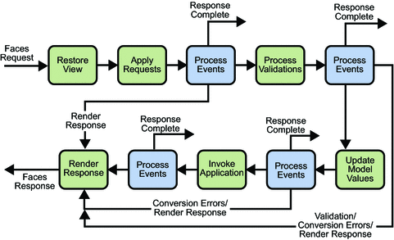
Lifecycle
JSF 101

Slide 17
Lifecycle
JSF 101
Restore view
Build the view of the page, connect event handlers and validators, etc
Save it all in FacesContext
Empty vs existing, depending on if initial or postback request
Apply request values
Each component grabs its values, automatically convert if possible
Process validations
Update model values
Update server-side components (any mapped entities for example)
Invoke action phase
Process any mapped actions
Render response
Besides rendering add any errors

Slide 18
Session Handling
JSF 101
Session
FacesContext.getCurrentInstance().getExternalContext().getSession(false)
Set/get attribute
Invalidate
Filters
@WebFilter + url pattern
doFilter()
If everything is ok -> chain.doFilter
Else redirect to login

Slide 19
Primefaces
JSF 101
Showcase
Primefaces demo

Slide 20
Part 02 – Small Project
JSF 101
Lets tie all of this together…
Login
Username, Password
Validate the input
Show error messages
Create user
Similar to Login
Users
List all users
CRUD operations
Logout

Slide 21
References / Resources
JSF 101
Java EE docs:
http://docs.oracle.com/javaee/5/tutorial/doc/bnaph.html
https://docs.oracle.com/javaee/6/tutorial/doc/
Vogella: http://www.vogella.com/tutorials/JavaServerFaces/article.html

Slide 22
Mihaly Fodor
Senior IT Consultant
+49 (0) 899 6101 2508
surname.name@msg-systems.com
msg systems ag (Headquarters)
Robert-Buerkle-Str. 1, 85737 Ismaning
Germany
www.msg-systems.com

